Slide 1

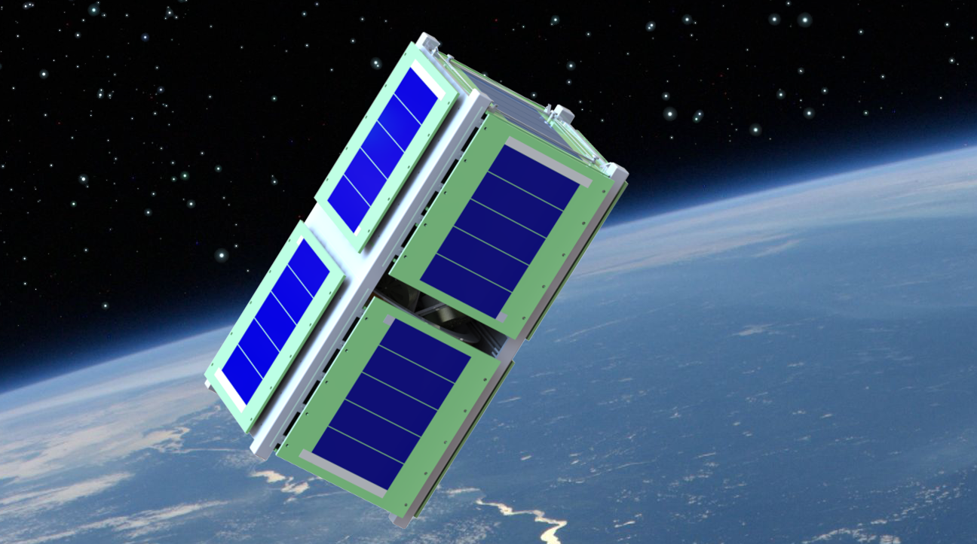
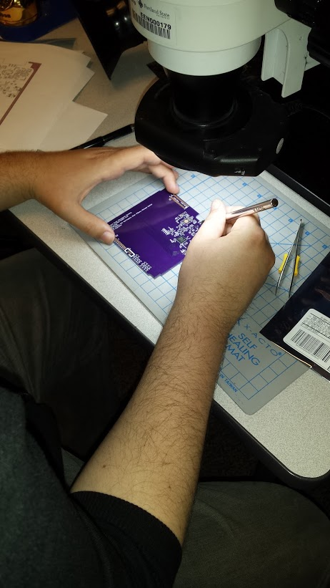
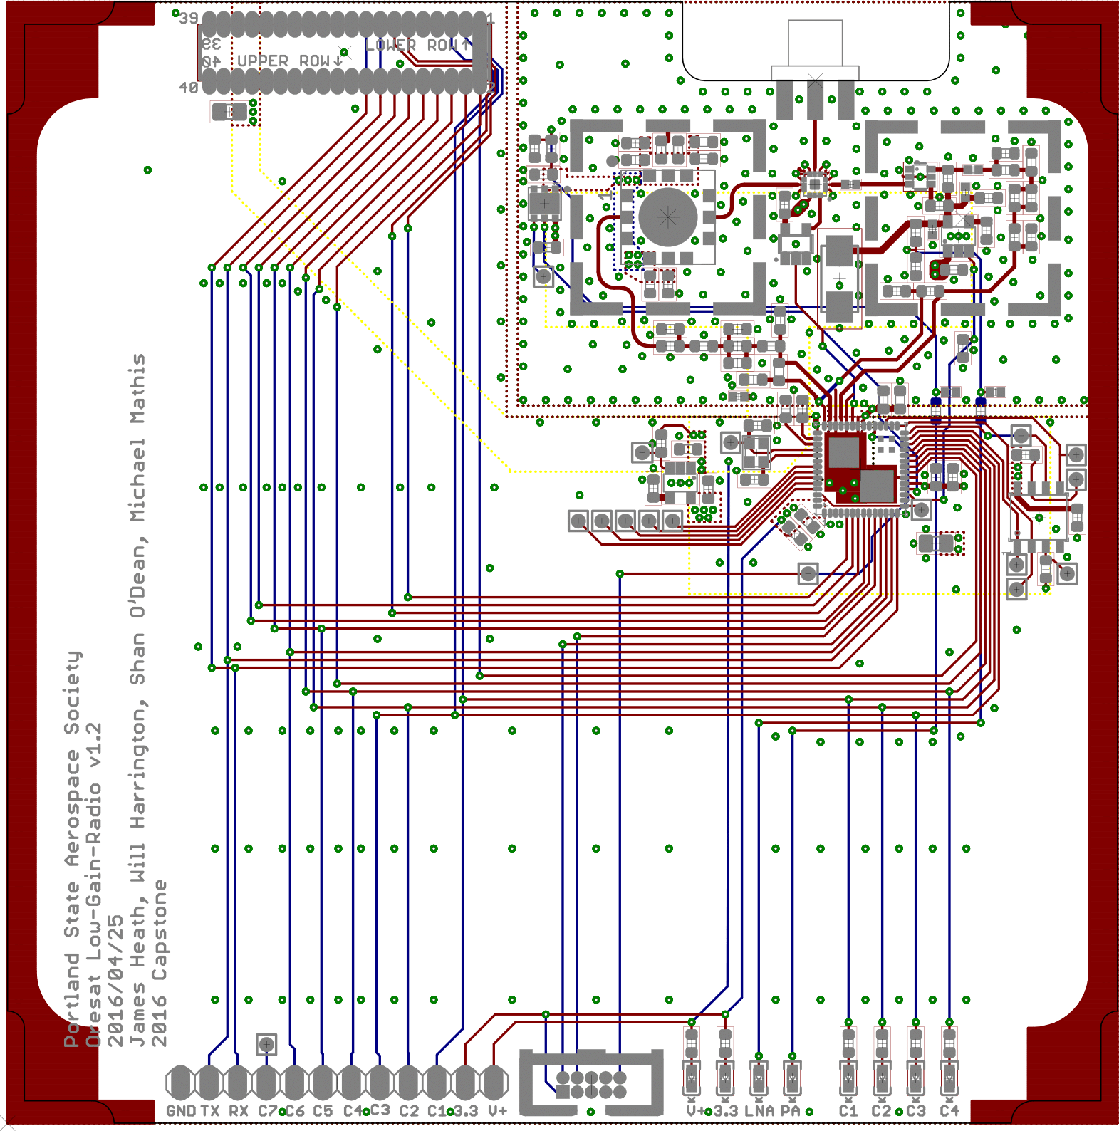
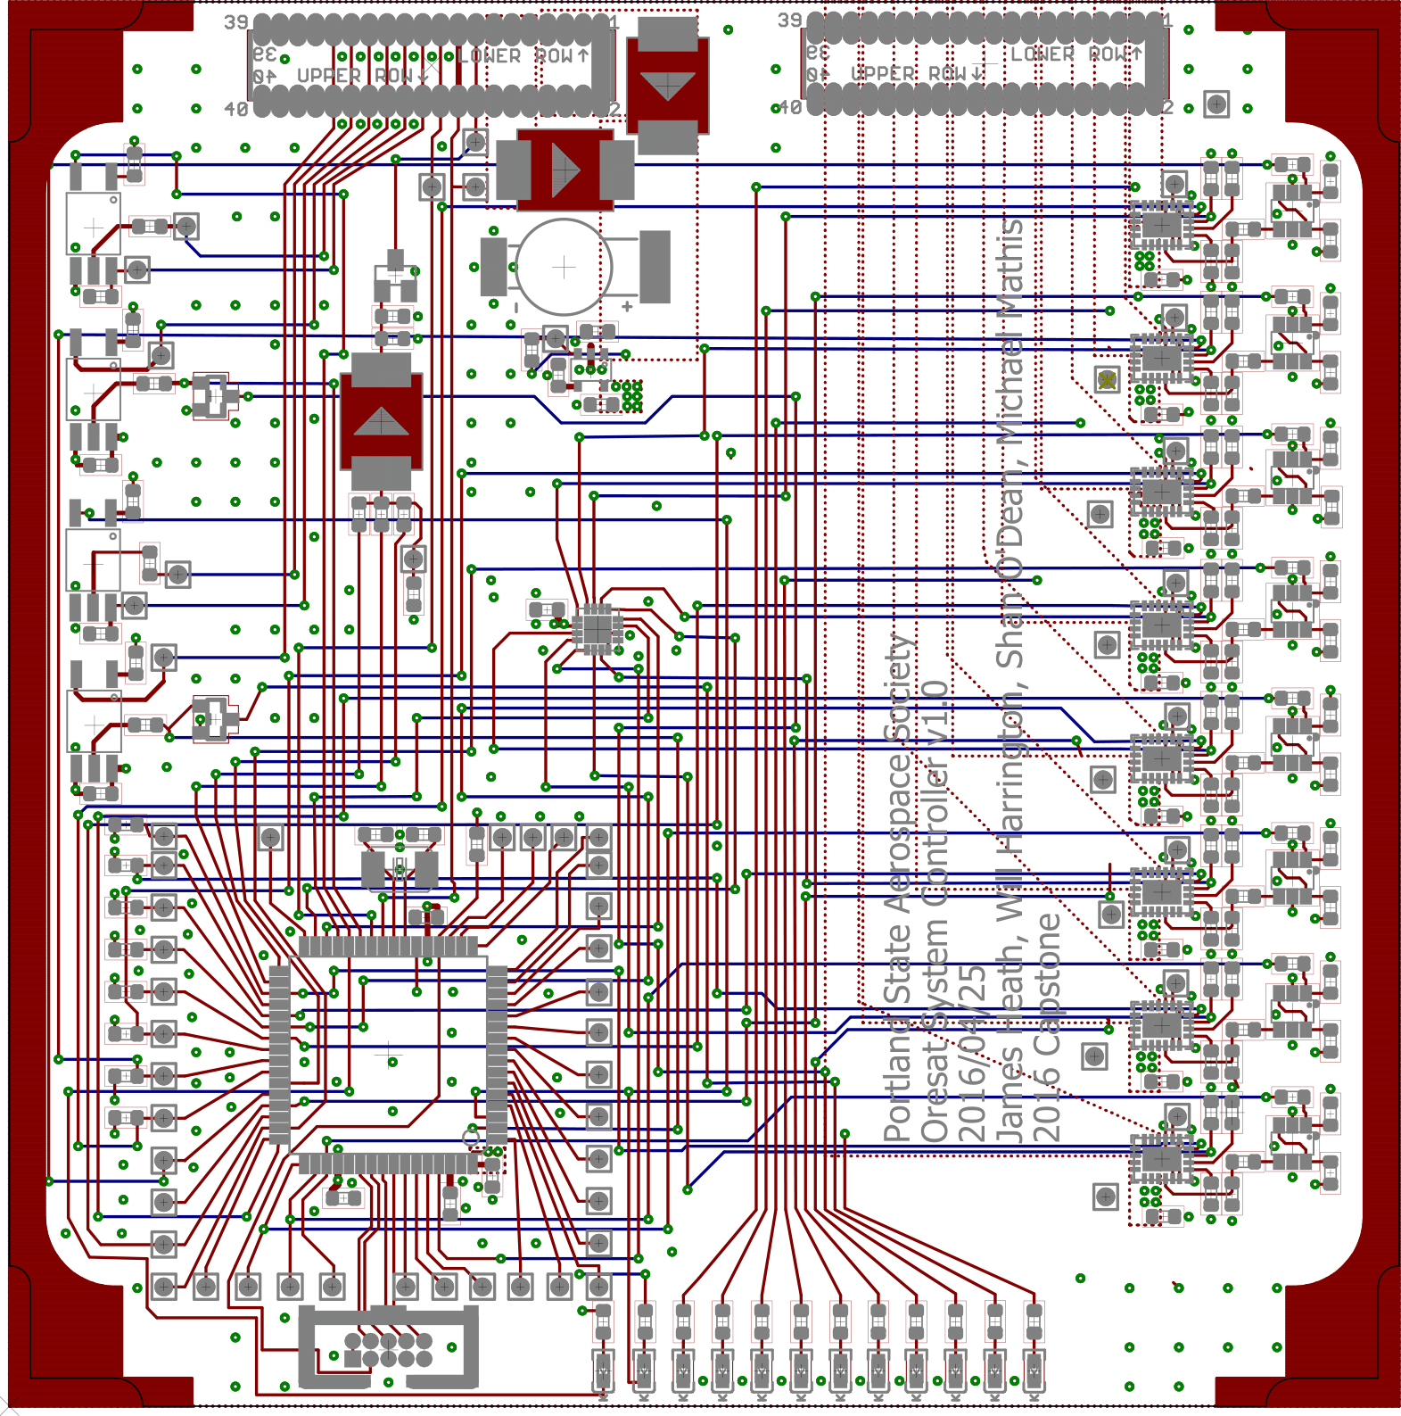
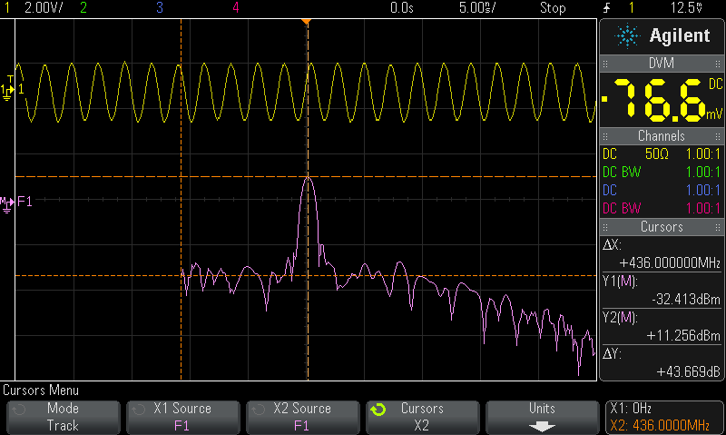
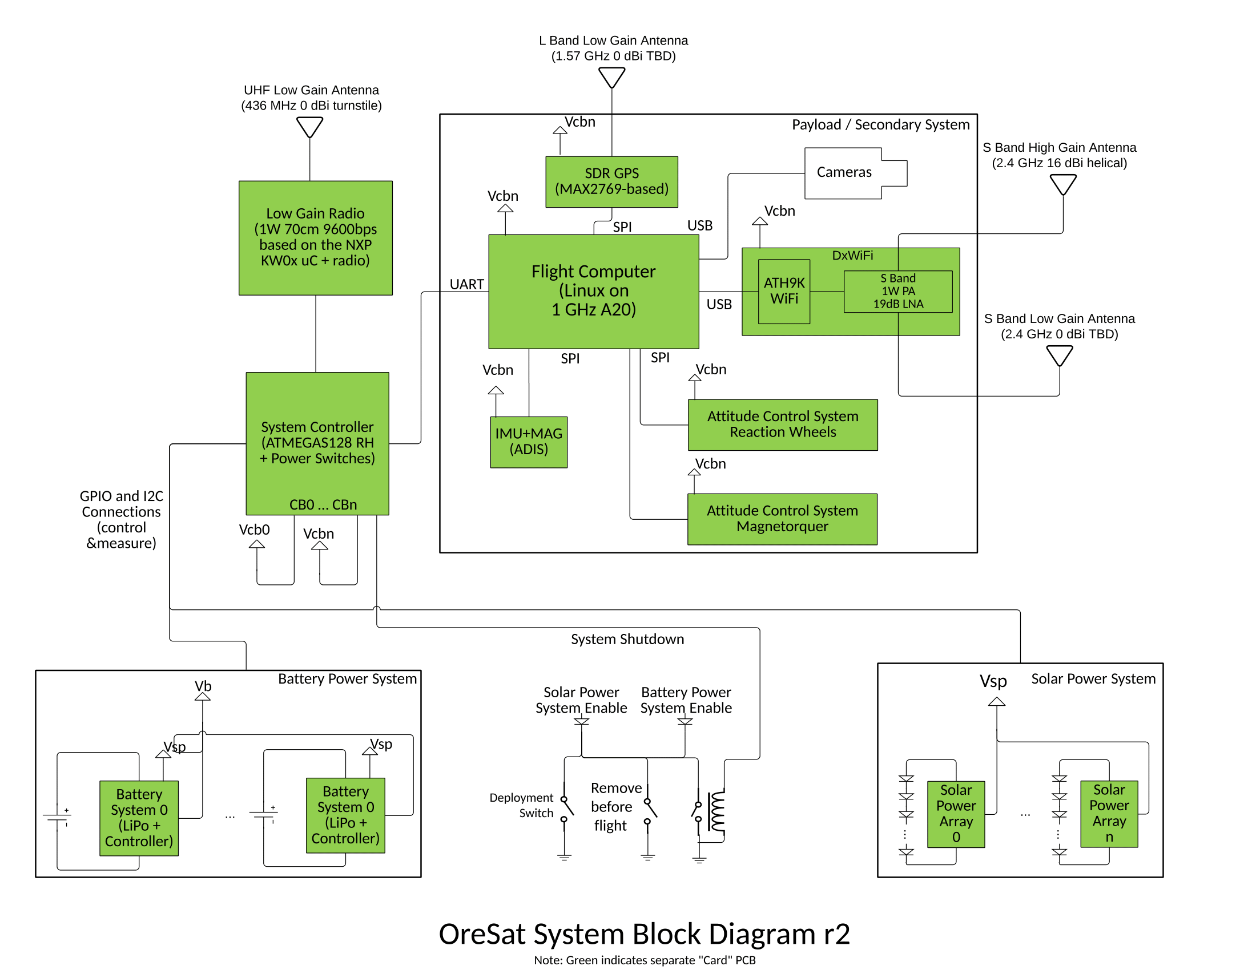
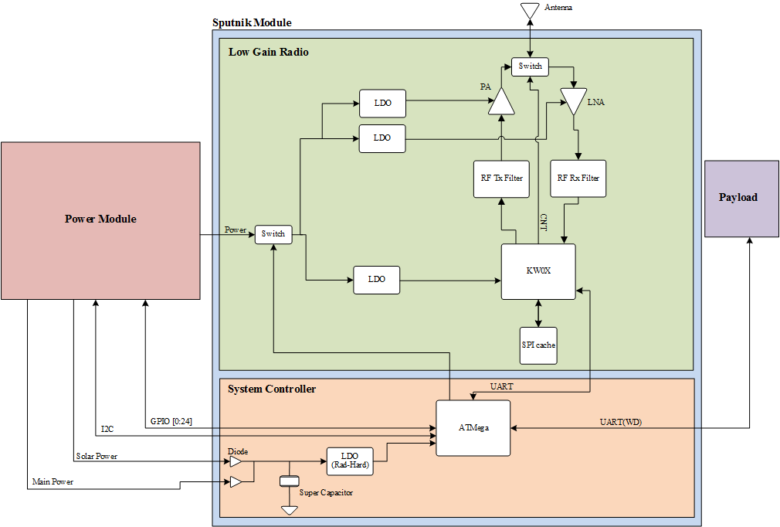
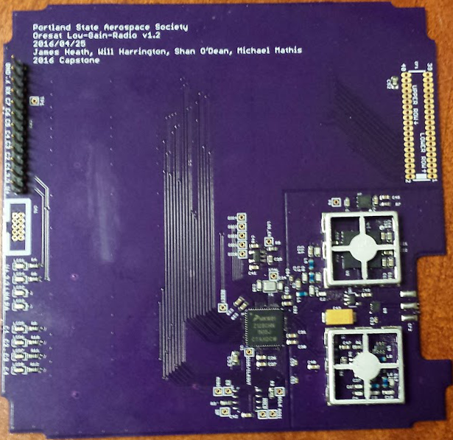
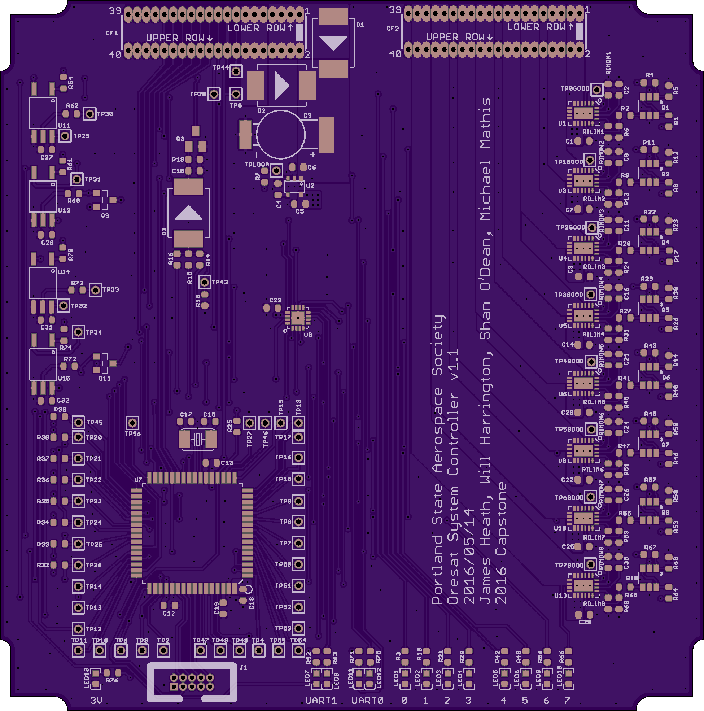

CubeSat Command Control
and Communications System
Project Team:
Will Harrington
Jake Heath
Michael Mathis
Shan Quinney
Special Thanks to:
Andrew Greenberg Theo Hill
Glenn Dr. Teuscher
PSAS The LID
Introduction
Current Results
The Portland State Aerospace Society (PSAS) is the lead on the Oregon Small Satellite Project. “OreSat” is a CubeSat form-factor nanosatellite designed for a low-earth orbit of 400 km.
OreSat requires a robust command, control, and communication (C3) system to control the satellite. The C3 system must communicate to the ground over 1,400 km (at acquisition of signal) at low data rates (9600 bps) while monitoring and controlling the power system of the satellite.
Design
Jake Heath working on an LGR module
Our design covers two of the many modules in OreSat
The boards need to be cut in order to fit properly.
The layout of the LGR (left) and the SC (right)
We split our design into two parts, the Low-Gain Radio (LGR) which handles communication and the System Controller (SC) which is in charge of command and control for the module. . The SC speaks UART and I2C to all the modules and can reset them individually. Even the power system can be turned off in case radiation causes a transistor to switch in a super bad way.
Spectrum analyzer
screenshot
Picture of us doing
the 10km test
Graph showing SOMETHING HARDWAREY (left)
Picture of MEMBERS OF TEAM performing a 10km communications test (right)
Completed boards for the LGR (left) and the SC (right)
Pictures of the finished boards LGR (left) and SysCon (right)
Department of Electrical and Computer Engineering

